Slide 1

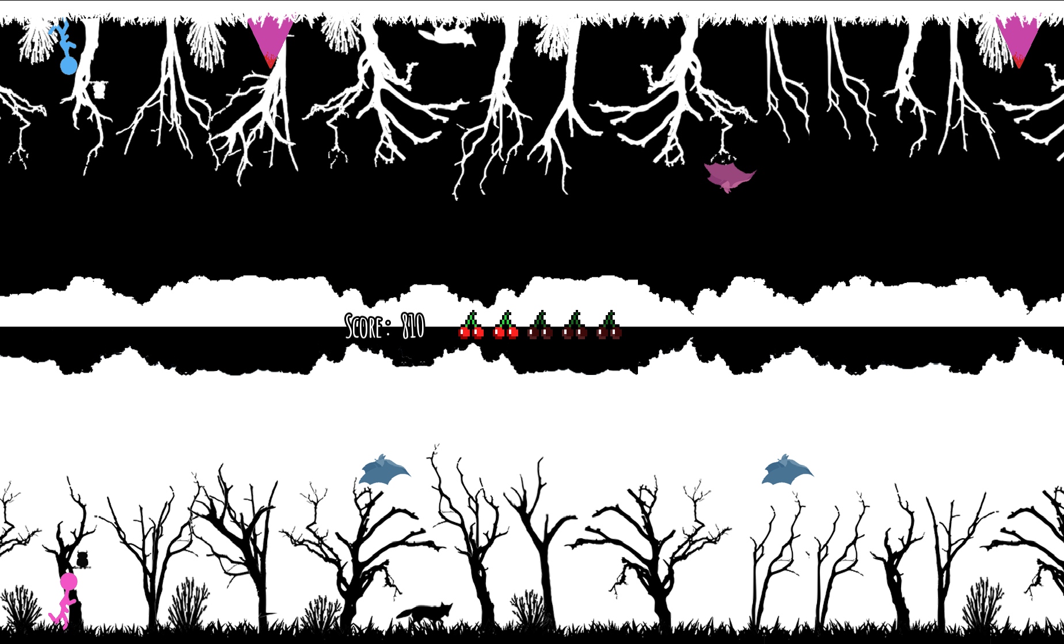
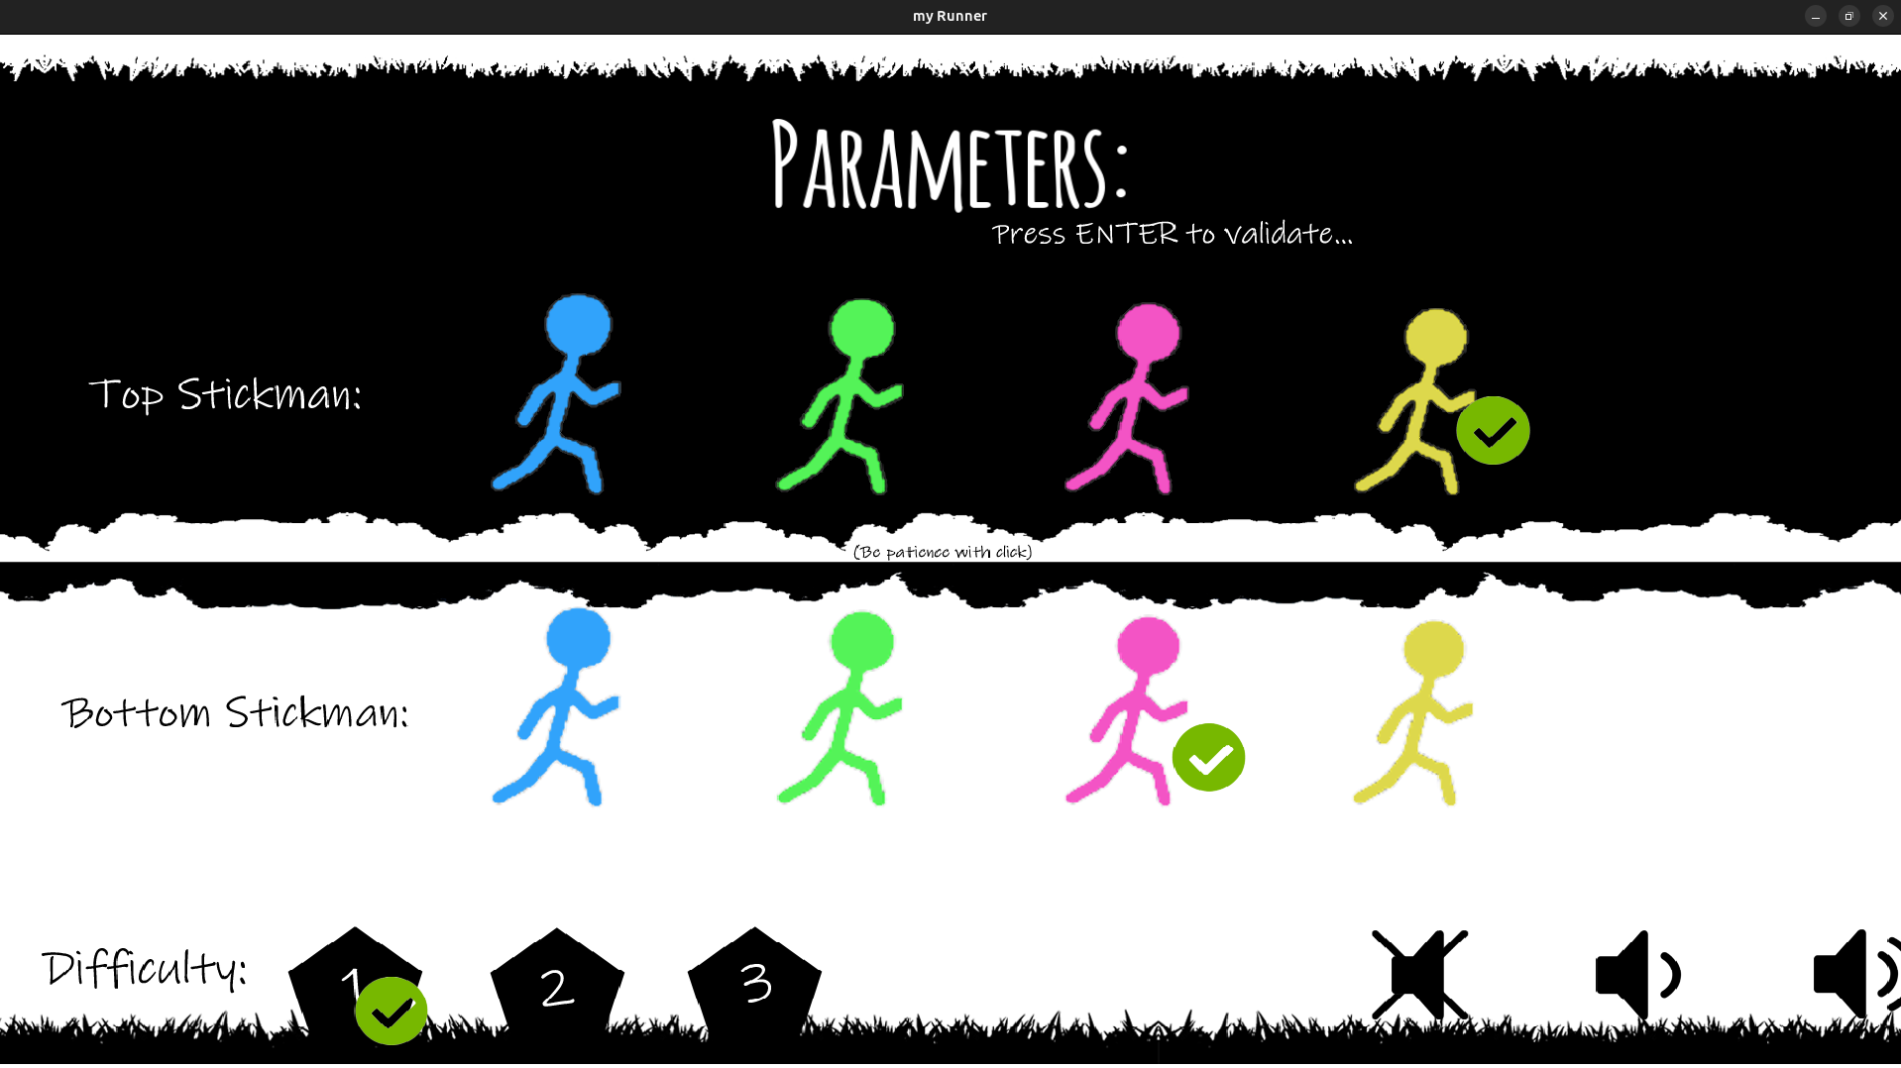

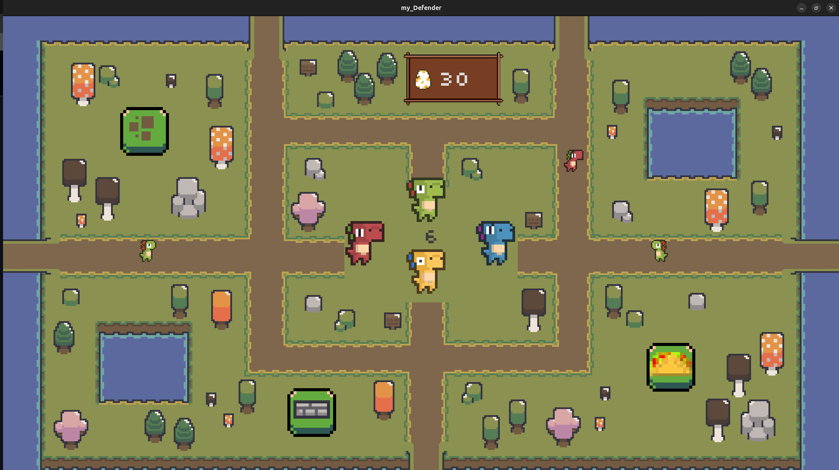
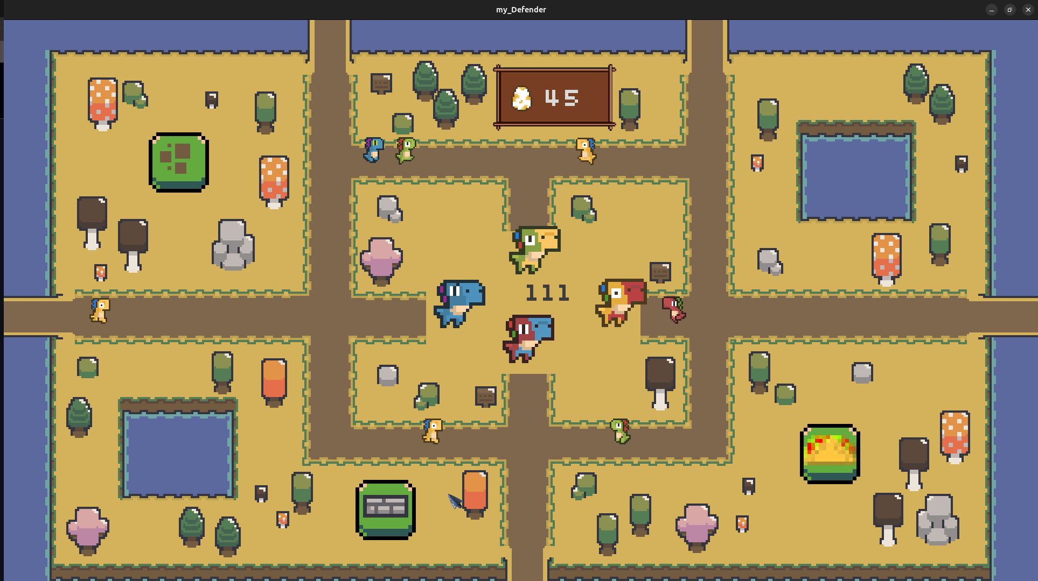
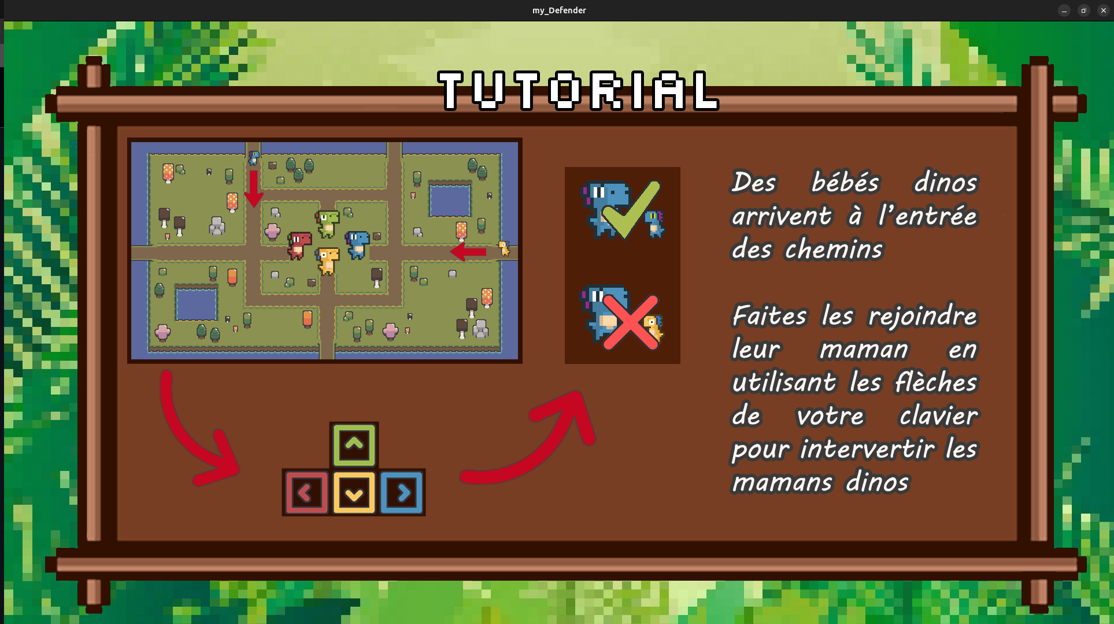
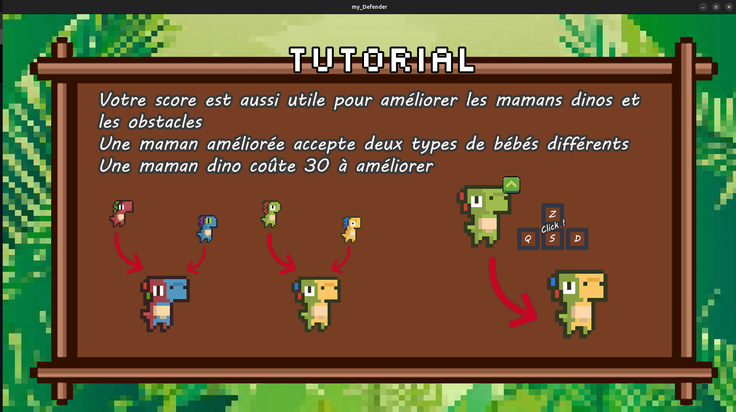
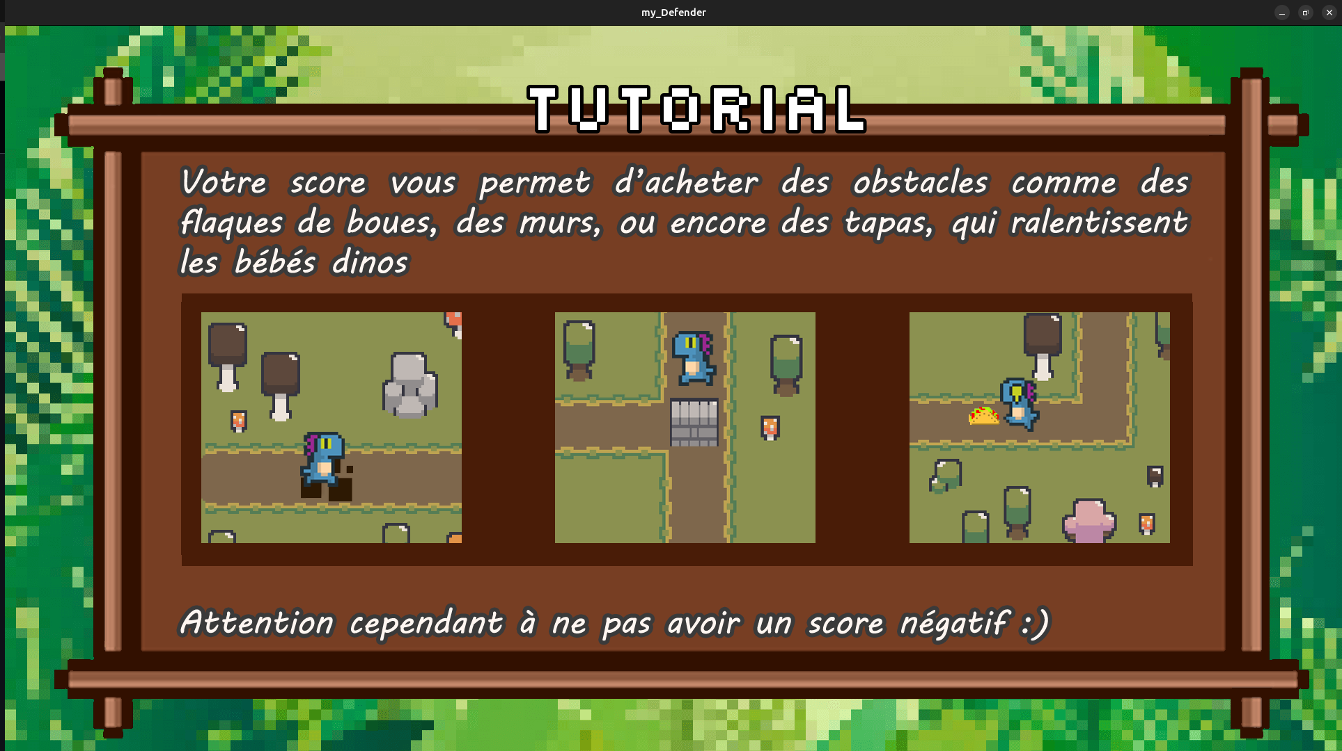

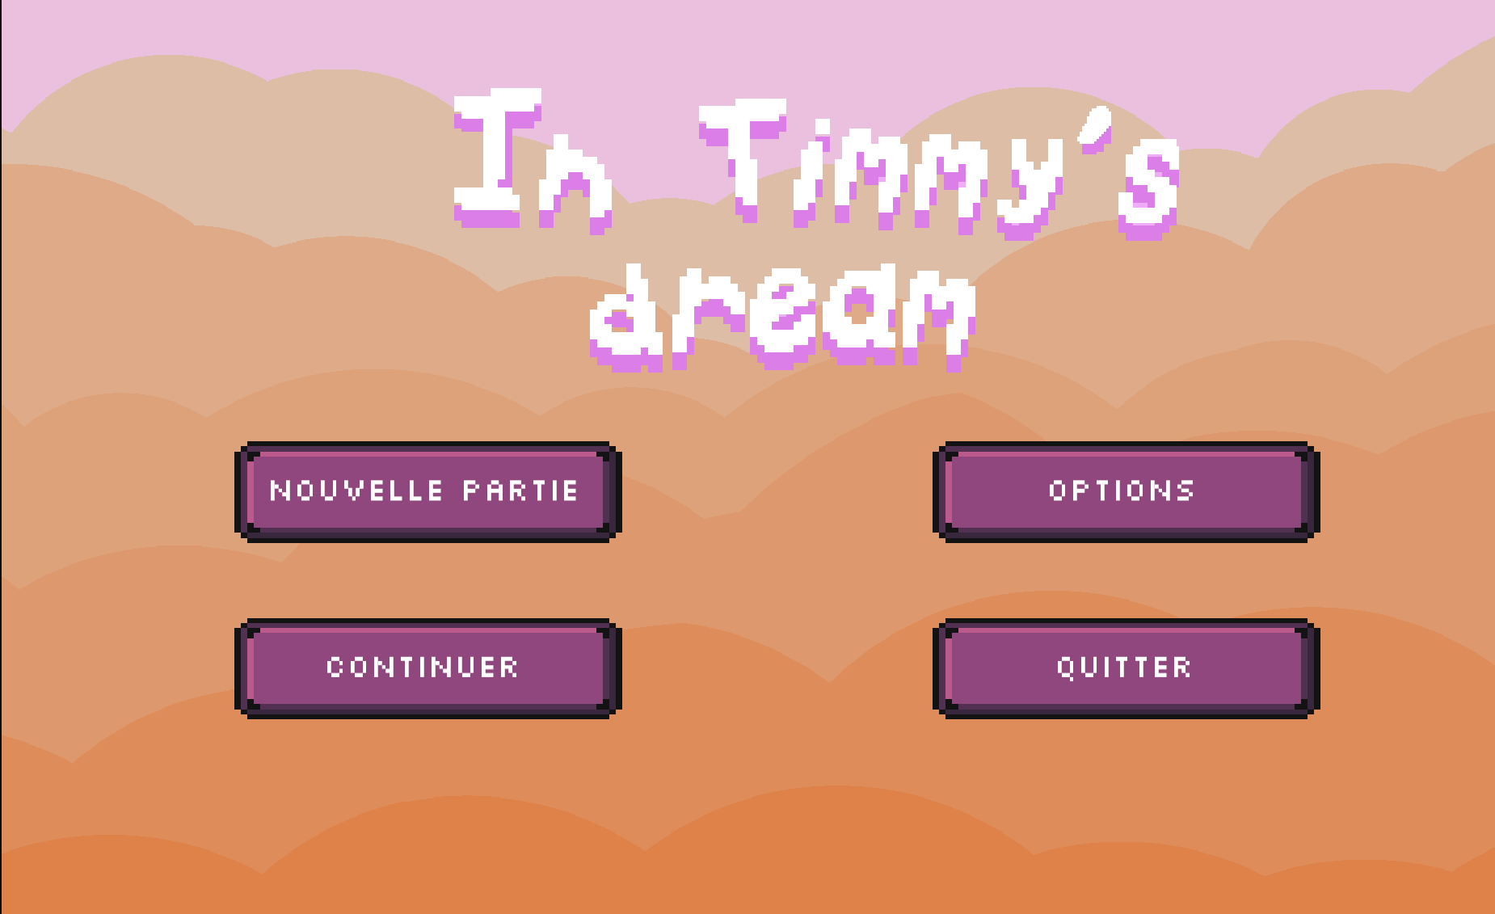
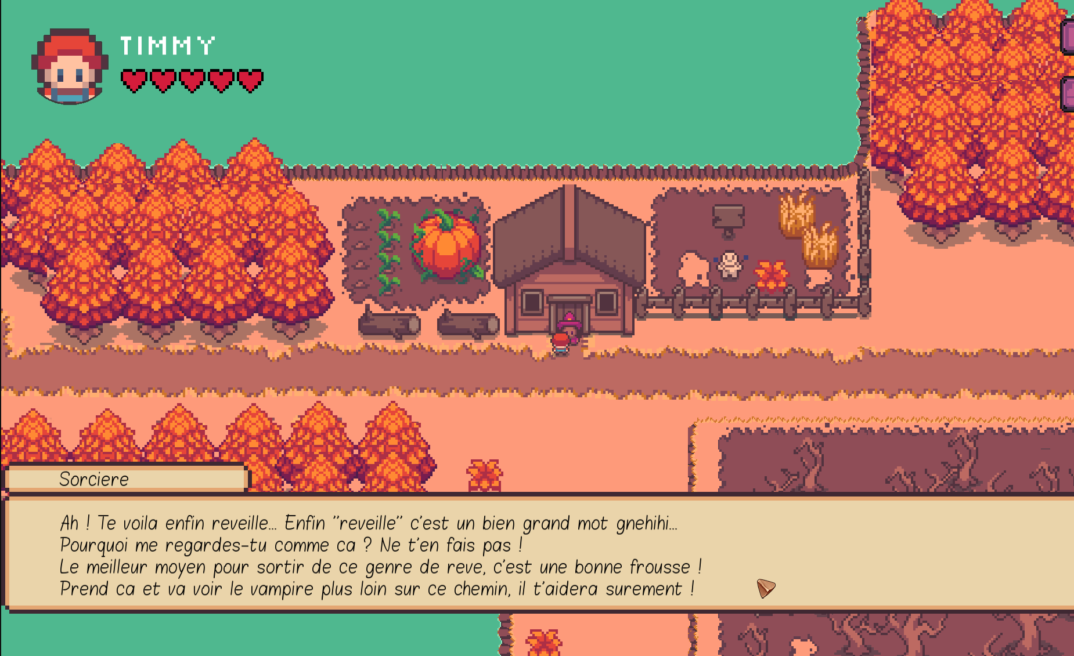
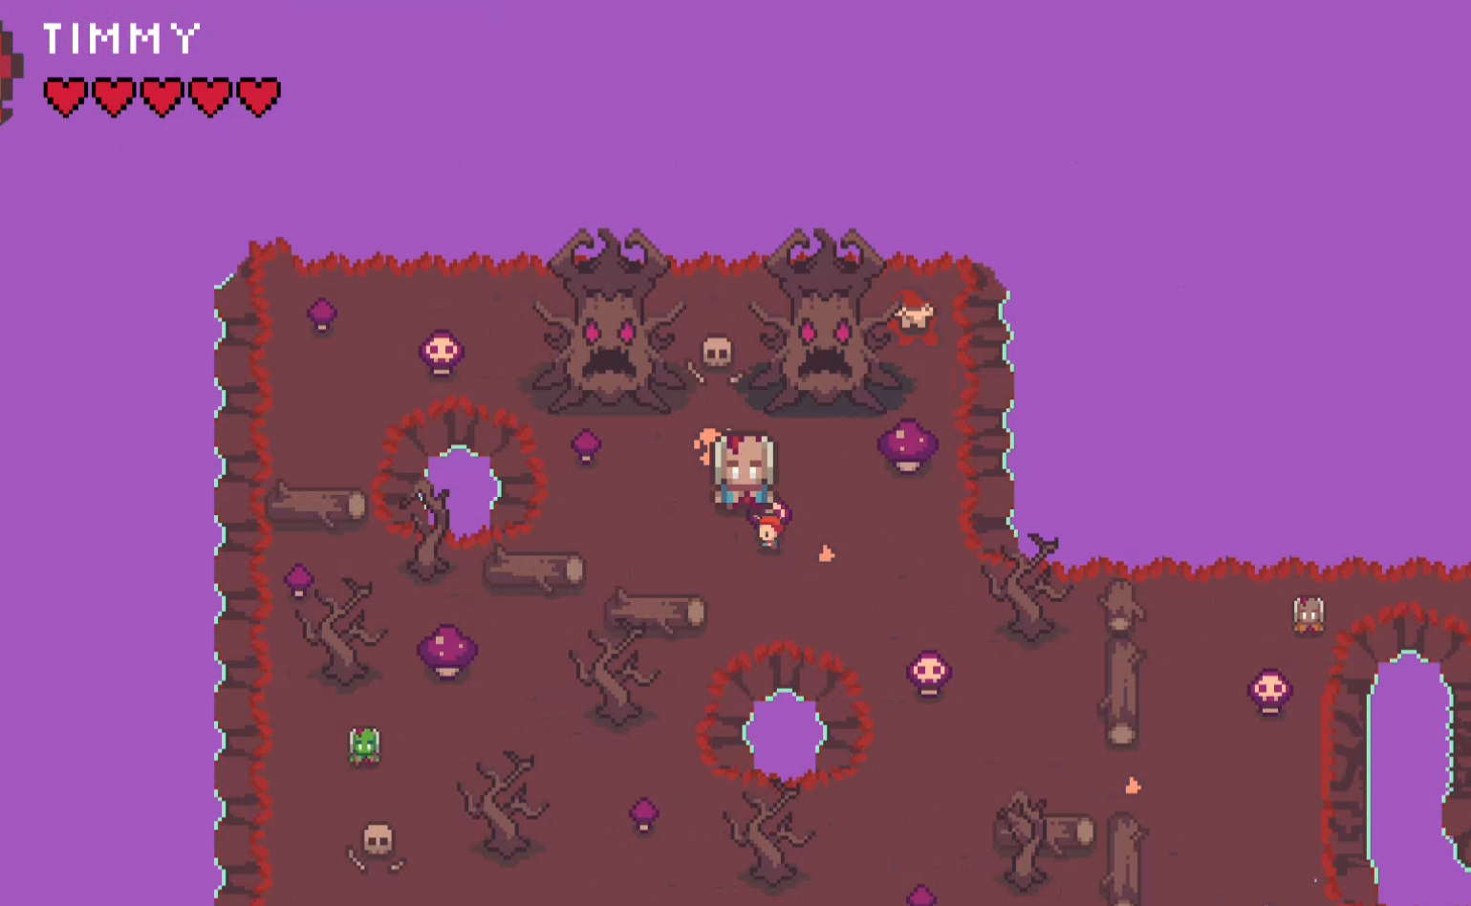


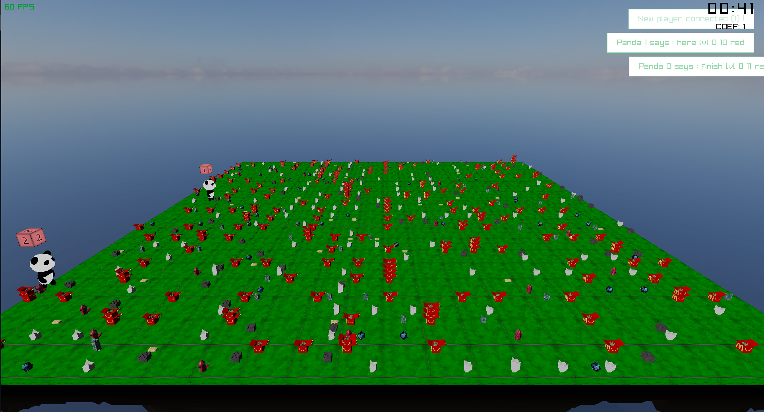

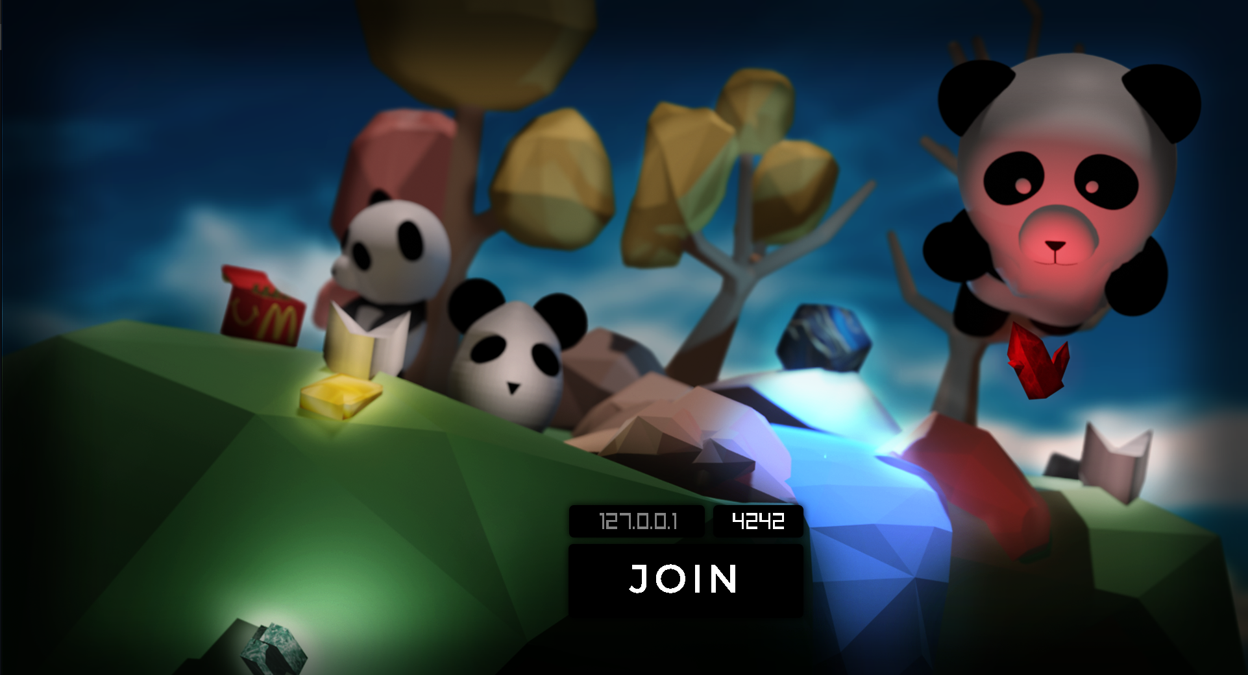
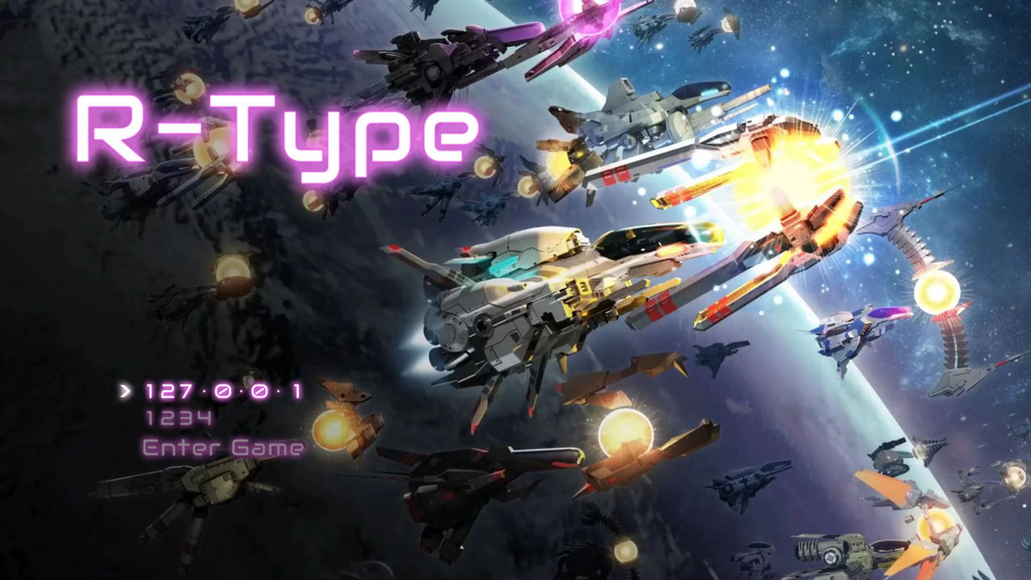

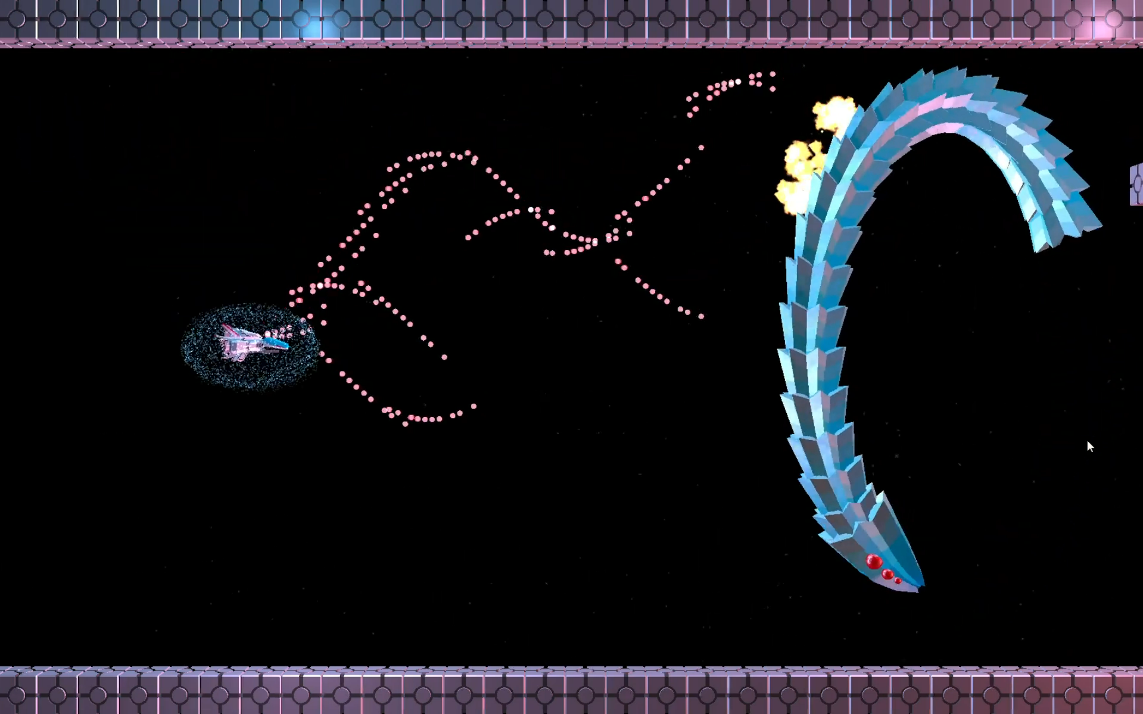
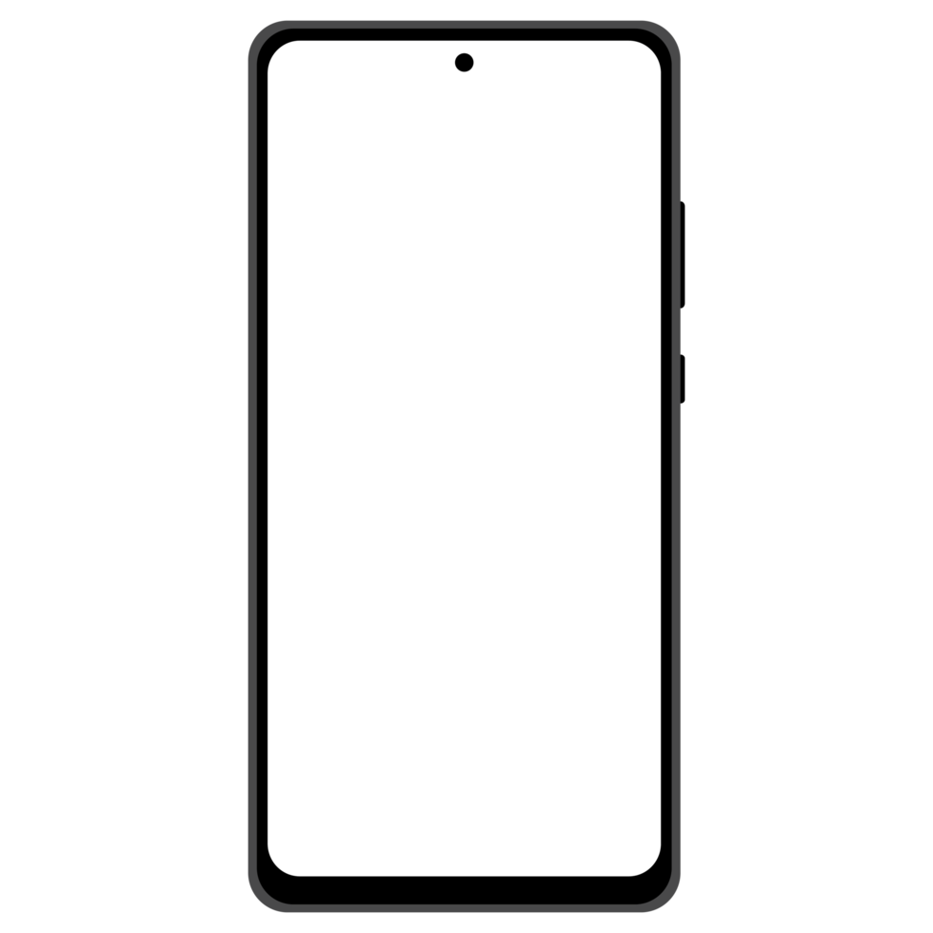
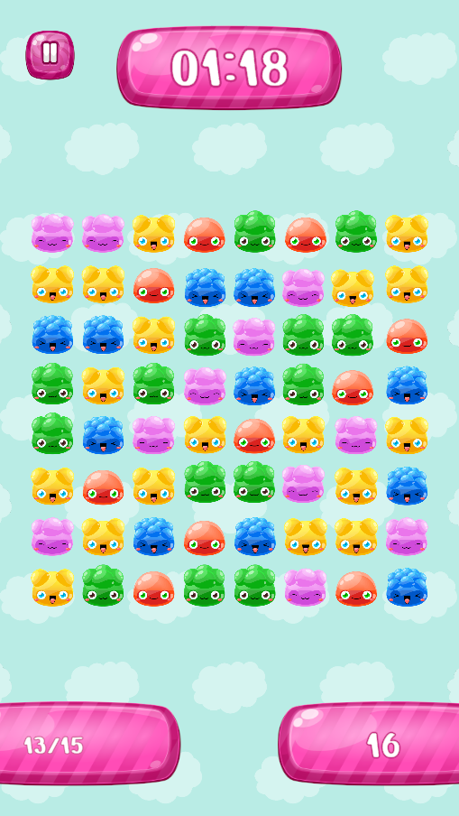
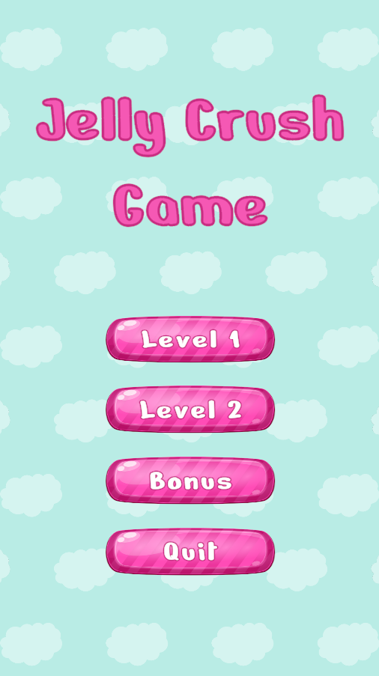


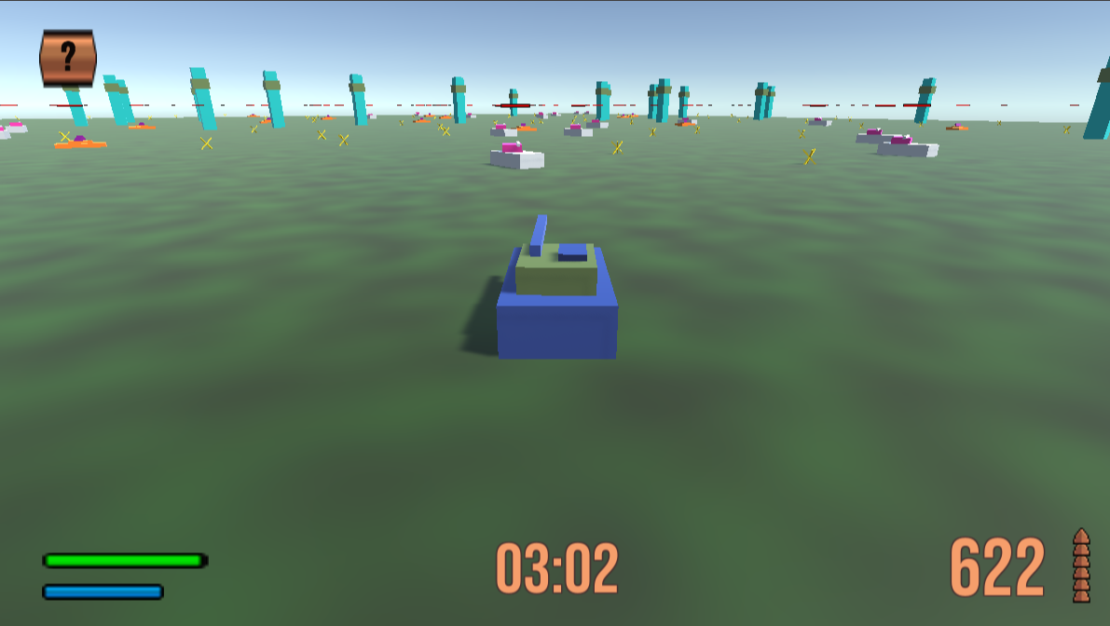

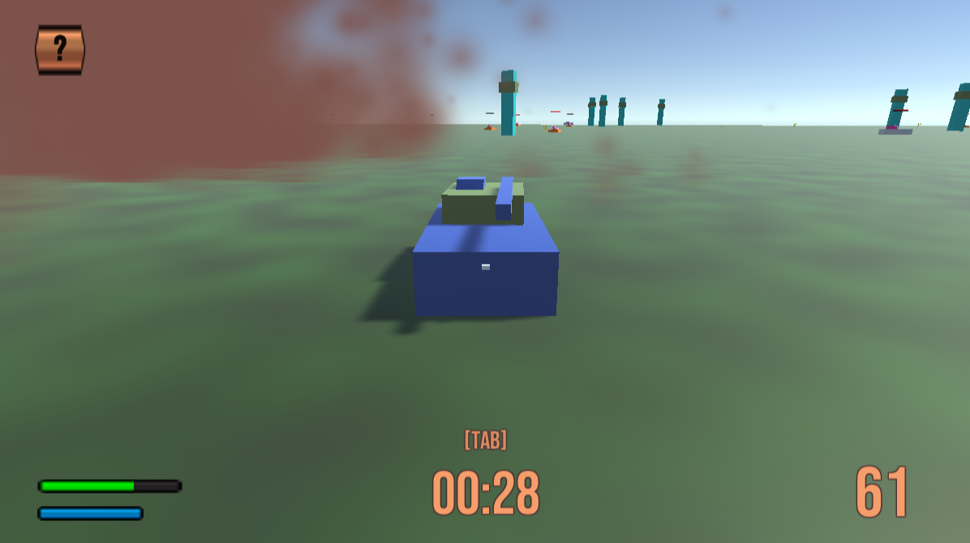

Marie
Giacomel
I am…
A 21 years old French computer science student • In exchange at Condordia • 4th year student at Epitech • Developer for the last 5 years (and probably the next 5) • C / C++ enjoyer • Trying to make the most of life
I like…
Coding • Logic • Reflection • Coherence • Plot twists • Be impressed • Be inspired • Be passionate • The taste for hard work • The job well done • Going the extra mile • Taking pride in my work
“Details make perfection,
but perfection isn't a
detail.”
My first graphical project,
made in C with csfml
My_Runner
Bi-dimensional runner game, the player has to pay attention to the top and bottom at the same time
See the game
My_Defender
My second game, made with csfml in C
Baby dino are coming from each path and want to join their mama, you need to swap the mama to match the baby coming to her
But It’s not as easy. The difficulty is increasing over time.
You can upgrade the mamas, so they match more baby’s color, or
put mud, wall or tacos to distract the babys and gain time.
See the game
End of first year project, made with csfml in C.
Timmy is afraid of Halloween, but one day, he wakes up in a world where Halloween is everyday!
You need to help Timmy to understand what happened to him. How did he wake up here?
Is he really awake?..
Watch the trailer
Zappy
3 in one project: GUI • Server • AI
Several AI teams spawn on a map and must find the resources they need to evolve
See the game
Made in C (server part), C++ with raylib (GUI part) and Python (AI part)
Multiplayer version of the R-Type retro game
R-Type
From scratch Entity Component System (ECS) made in C++ with raylib for graphics
3D shooter game with handmade models, level, light and particle effects
See the game
Jelly Crush
First mobile project made with Unity
Candy Crush like with custom appearance rate of the candy
Play it
Tank Escapist
The player controls a tank who has to survive as long as possible while being pursued by a toxic gaz and targeted by enemies
Play it
48h project made with Unity in C#
The best is yet
to come…

